Slide 1

Análisis de Señales
SLIT’s Discretos
Dr. José Ramón Iglesias
DSP-ASIC BUILDER GROUP
Director Semillero TRIAC
Ingenieria Electronica
Universidad Popular del Cesar

Slide 2

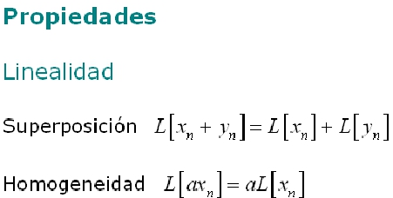
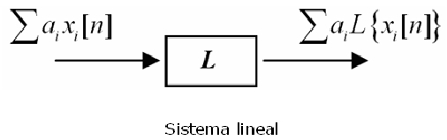
Ing. José Ramón Iglesias Gamarra P.hd

Slide 3
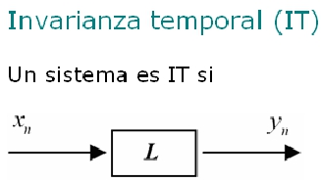


Ing. José Ramón Iglesias Gamarra P.hd

Slide 4
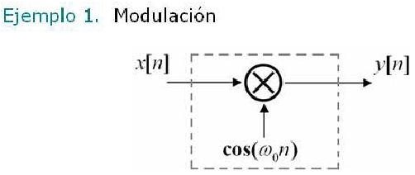

Ing. José Ramón Iglesias Gamarra P.hd

Slide 5
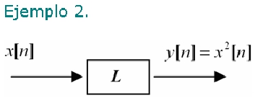

Ing. José Ramón Iglesias Gamarra P.hd

Slide 6
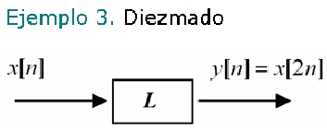

Ing. José Ramón Iglesias Gamarra P.hd

Slide 7
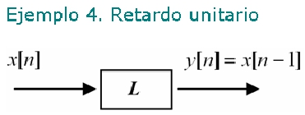


Ing. José Ramón Iglesias Gamarra P.hd

Slide 8

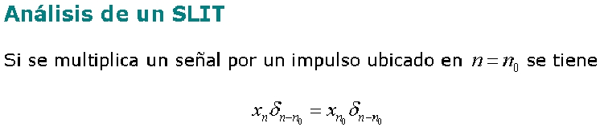



Ing. José Ramón Iglesias Gamarra P.hd

Slide 9



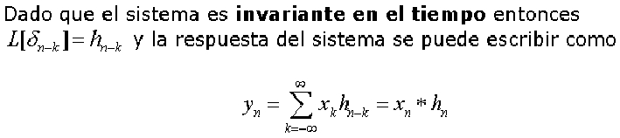

Ing. José Ramón Iglesias Gamarra P.hd

Slide 10



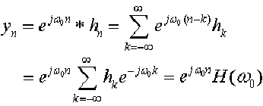
Ing. José Ramón Iglesias Gamarra P.hd

Slide 11






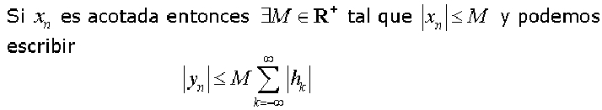
Ing. José Ramón Iglesias Gamarra P.hd

Slide 12




Ing. José Ramón Iglesias Gamarra P.hd

Slide 13





Ing. José Ramón Iglesias Gamarra P.hd

Slide 14
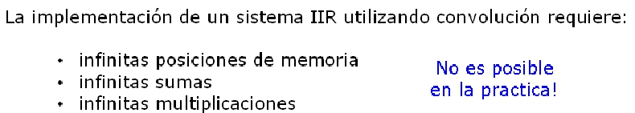


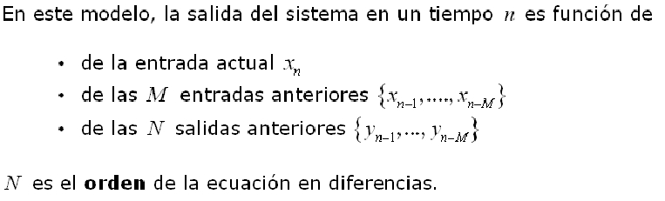

Slide 15

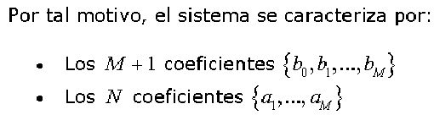



Ing. José Ramón Iglesias Gamarra P.hd

